Slide 1
Travel Pilot Workstation/Device Requirements

Slide 2
Standard Web Browser Requirements Desktop/Laptop
System | Internet Explorer | Firefox | Accessibility *
Travel Hub, AFIS & HRM | 9 to 11 on WIN 7 11 on WIN 8.1 11 on WIN 10 | ESR 45 | Window Eyes 8 or JAWS 14
Legend:
* Accessibility recommendations work with AFIS & HRM. Further testing is needed to confirm use for Travel Hub.
2

Slide 3
Standard Web Browser Requirements Tablet/Mobile Devices
System | Edge | Firefox | Safari | Chrome | Android
Travel Hub, AFIS & HRM | 25.x, 13.x* | 49 (Android) | IOS 9.3.x** | 56 | 6.x
Legend:
Accessibility apps/software have not been tested; i.e. JAWS, standard device accessibility settings, voice recognition.
* Edge users will receive a message stating the browser is not supported. Click OK to continue. Testing completed so far has been successful.
** Safari 10.x will be compatible in the 1st half of 2017. Safari browser support is specifically provided for the mobile version of Safari on Apple iPad. Any issues encountered while attempting to use Safari on an Apple iPhone, Safari for Microsoft Windows, or Safari for Apple Macintosh should first be recreated on Safari for Apple iPad. If the issue cannot be recreated on the CGI Advantage supported platform, please contact Apple for additional support.
3

Slide 4
Standard End-User Workstation Requirements
System | Operating System | Processor / Memory | NIC | Hard Drive | Resolution (Min/Rec)
Travel Hub, AFIS & HRM | Windows 7, 8.1 & 10 | 1 GHz / 2 GB | 10 Mbps | 80 GB | 1024X768 / 1280X1024
Legend:
NIC = Network Interface Card; MIN = Minimum Resolution Required; REC = Recommended Resolution
4

Slide 5
Standard Connectivity Requirements
Travel Hub is web based and can be accessed from any internet connection
AFIS & HRM are web based and must be accessed from a State Network Connection
You may need to request VPN access if needing to connect to AFIS or HRM from a location outside of the Arizona State Network

Slide 6
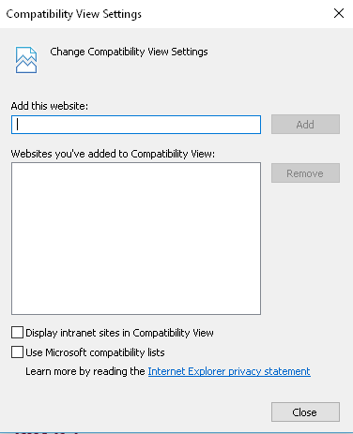
Travel Hub Specific Requirements
Travel Hub requires that you do not have compatibility settings for az.gov. Please ensure your compatibility settings are off if you use Travel Hub.
On Internet Explorer, in the top right corner of your Explorer window,
click > Compatibility View Settings.
You should see a screen like the one to the right. Confirm that az.gov is not entered in the lower box.
Click Close.
Restart your browser for the new settings to take effect (all sessions/tabs must close)

